Slide 1



MLTSDC: Multi Level Transformer Based Sugarcane Disease Classifier
Presented By:
Harsh Nandan Verma (2106216)
Shivam (2106217)
Rohan Kumar Choudhary (2106225)
Under the Supervision of
Dr. Shyam Singh Rajput
Assistant Professor
Department of Computer Science and Engineering
National Institute of Technology, Patna

Slide 2

Table of contents
01
Introduction
09
Comparison among QLoRA models
02
Problem Statement
10
Implementation Details
03
Dataset Description
11
Result
04
Literature Survey
05
Model Architecture
12
Conclusion
06
Flow of Information
13
Future Works
07
Low Rank Adaptation
08
14
References
Quantized Low Rank Adaptation

Slide 3
01
Introduction

Slide 4

Introduction
Why AI in Field?
What is benefit of ml model over human audit?
AI in disease identification for agriculture helps detect plant diseases early through image analysis, sensors, and machine learning models. It enables accurate diagnosis, reduces crop losses, and provides timely interventions, ensuring healthier crops and higher yields.
Machine learning models improve audit speed and accuracy by quickly processing large datasets, reducing human errors, and detecting anomalies or patterns that might be missed by manual audits.
ML models are highly scalable and cost-effective, providing consistent, unbiased results without fatigue. This automation reduces audit times, enhances efficiency, and allows for more frequent data reviews at lower costs.

Slide 5
What’s the status of loss due to plant diseases?
Climate-related factors, such as temperature, light, water, precipitation, and extreme weather are crucial for global sugarcane production. However, climate change has led to drought, heat stress, insect pests, and diseases, which limit crop productivity.
Pests and diseases, including approximately 100 fungi, 10 bacteria, 10 viruses, and 50 nematodes, contribute to declining crop yield worldwide. Sugarcane yield losses are primarily caused by diseases, such as rust (20%), smut (75%), ratoon stunting disease (RSD) (40%), and mosaic virus infection (40%), which lead to 37% global agricultural production loss[1]
Each year, plant diseases cost the global economy around $220 billion, and invasive insects around $70 billion, according to the Food and Agriculture Organization of the United Nations.

Slide 6
02
Problem Statement

Slide 7
Developing a precise and efficient method for sugarcane leaf disease

Slide 8
03
Literature
Survey

Slide 9

Literature Survey
Recent literature in sugarcane disease classification showcases advancements in machine learning techniques such as transformer, CNN and ensemble methods for accurate and automated diagnosis.
We conducted a survey of several papers related to this topic and discovered the following details:
A study by Xuechen Li et al.[2] aimed to combine the advantages of CNN and transformer for sugarcane leaf disease classification and proposed a model U-RSwin T and a method sugarGAN segmentation to preprocess dataset .
There Model U-RSwin T achieved accuracy of 97.81% Utilizing leaf augmentation via CNN.
However, the proposed model had a large amount of parameters 7.86M, which makes the model infeasible to implement in low end devices in farm field.

Slide 10
04
Database
Description

Slide 11
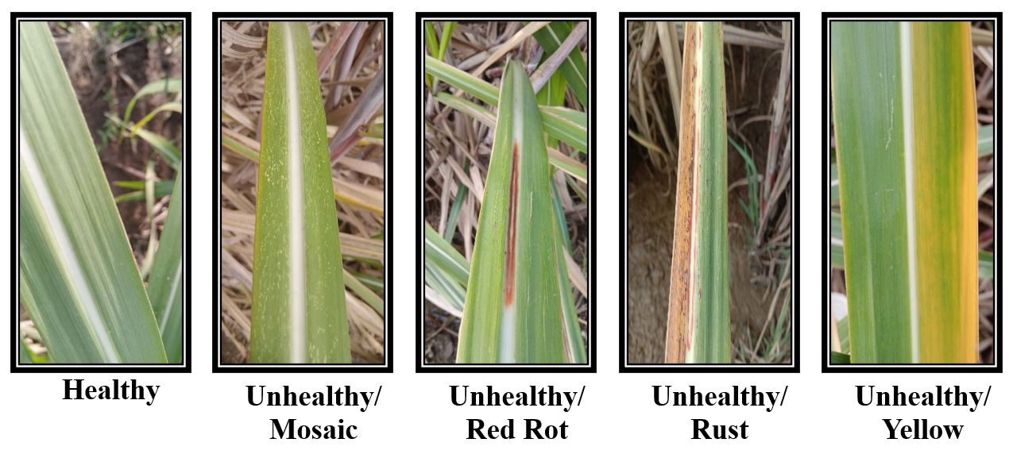
Database Description
The model is designed for the farmers to be utilized in the fields, and the farmers won't be able to provide the image of a leaf in a scientifically controlled environment. Hence it becomes important for our model to be capable of handling the background noise in the image.
We have taken noisy leaf images of sugarcane crop from publicly available Kaggle dataset[ref], which has overall 2521 images across various classes. It contains healthy and unhealthy classes, where unhealthy class includes diseases from 4 classes namely Mosaic, Red Rot, Rust and Yellow. The dataset thus formed on lowest level has 5 classes.

Slide 12
05
Model
Architecture

Slide 13

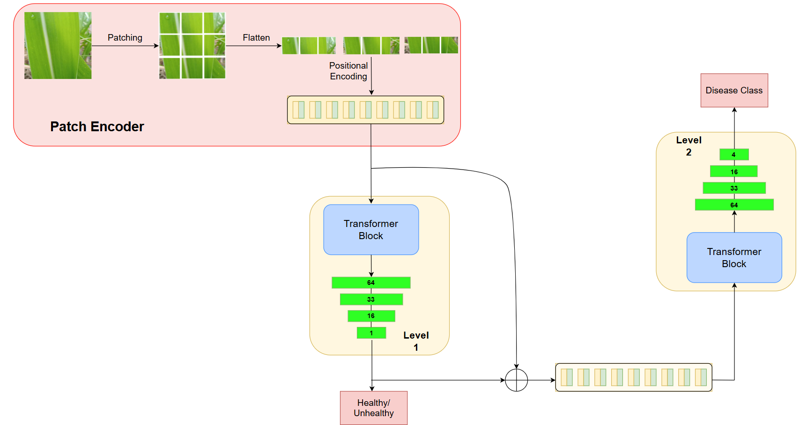
Overview of Our Model

Slide 14
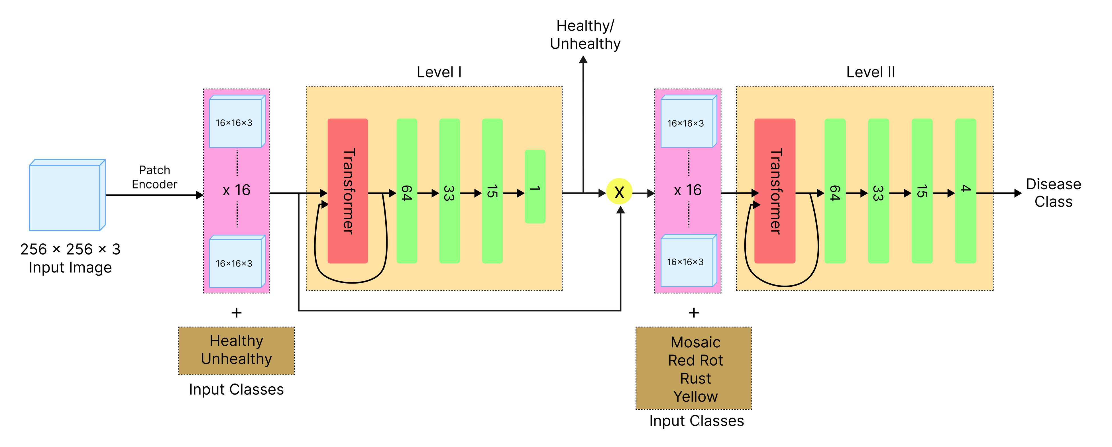
Architecture of the Model

Slide 15
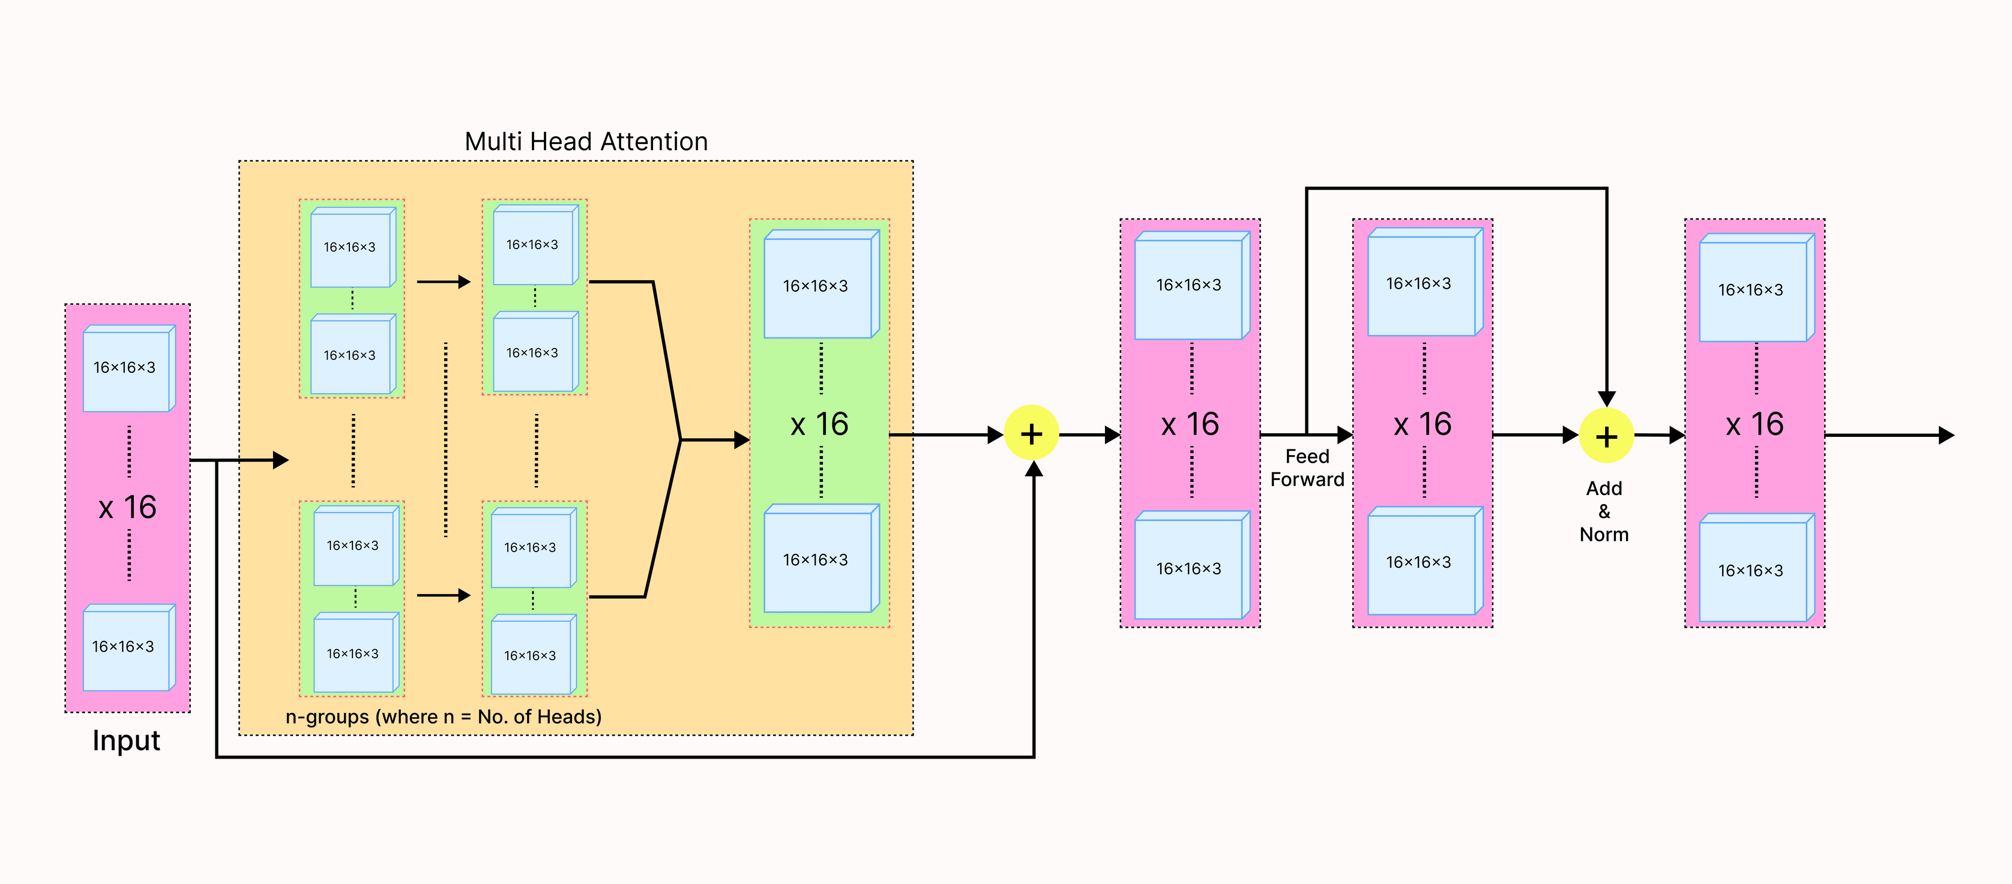
Transformer Block of the model

Slide 16
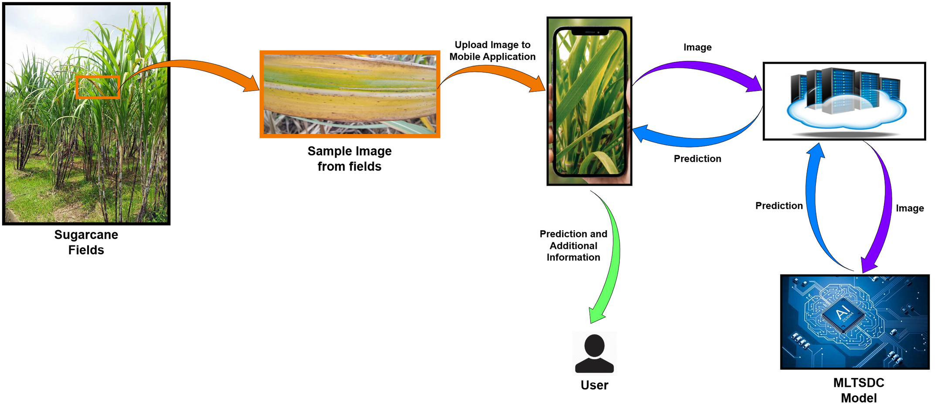
06
Flow of Information

Slide 17
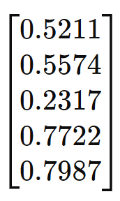
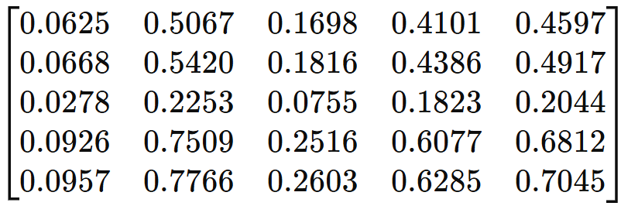
07
Low Rank Adaptation (LoRA)
2
Space Complexity Improvement: O(N ) --> O(2N) = O(N)

Slide 18
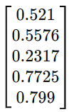
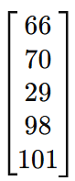
08
Quantized Low Rank Adaptation (QLoRA)
Quantization is conversion from higher memory format to lower memory format.
Float32
Float16
Int8

Slide 19
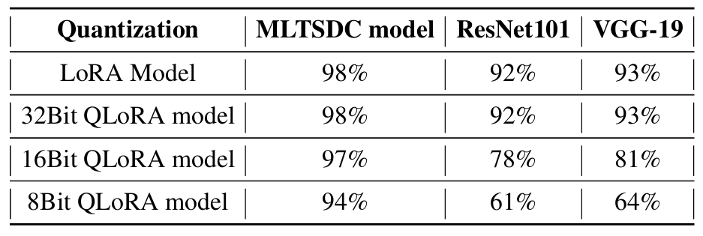
09
Comparison among QLoRA models

Slide 20
10
Implementation
Details

Slide 21
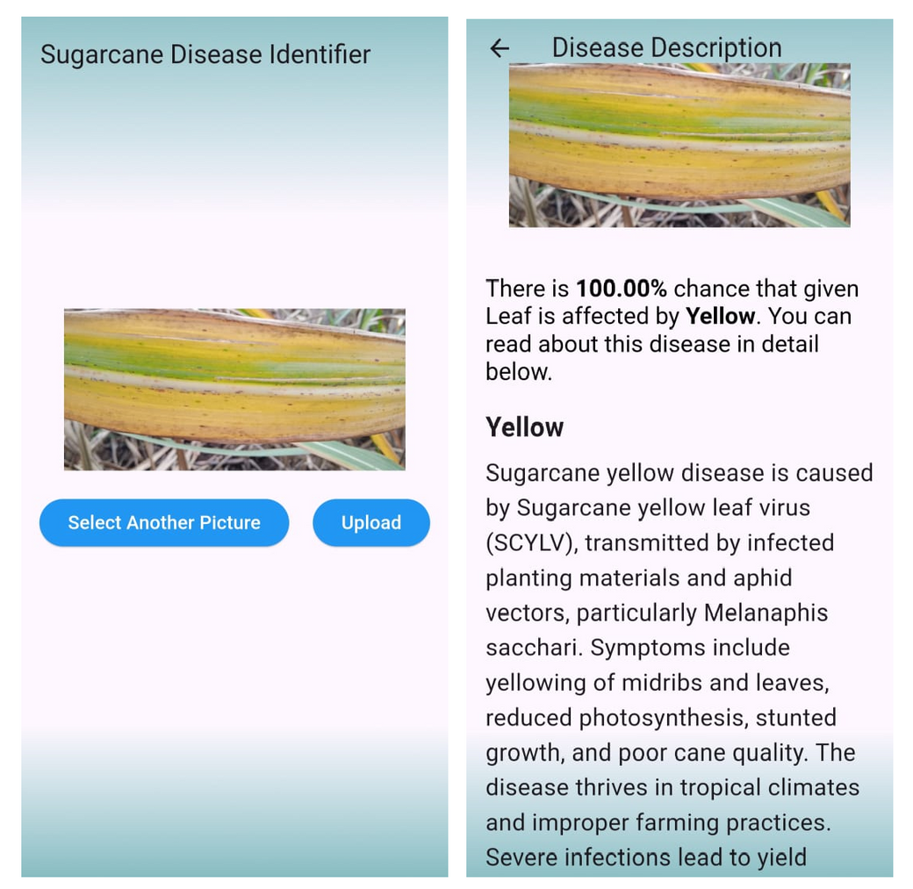
Real Time Implementation

Slide 22
Dataset Preparation
Data preprocessing
Data Labelling
The first step involved gathering a dataset of plant images containing both healthy and diseased plants. These images were preprocessed by resizing them to a standard size, typically square dimensions like 256x256 pixels, and normalizing pixel values to a range between 0 and 1. Data augmentation techniques such as rotation, flipping, and zooming were applied to increase dataset diversity and improve model generalization.
Only for Training dataset, we update the labels so that they have multi-level class labels. Healthy Labels are left untouched, whereas diseases labels are updated to represent first parent class Unhealthy followed by disease name.

Slide 23
Model Implementation
Model Training
Model Evaluation
The vision transformer model was trained using the preprocessed dataset. Training occurred over multiple epochs, with monitoring of training metrics such as loss and accuracy. The model's performance was also validated on a separate validation set to assess its ability to generalize to unseen data.
The trained model was evaluated on a test dataset to measure its classification performance using metrics like accuracy, precision, recall, and F1 score. Hyperparameters were fine-tuned as necessary to achieve optimal results.

Slide 24
11
Results

Slide 25
We used various metrics like accuracy, precision, recall and f1-score as shown below:
 | Overall | Class Wise | Class Wise | Class Wise | Class Wise | Class Wise
 |  | Healthy | Mosaic | Yellow | Rust | Yellow
Accuracy | 98.81% | 100% | 98.83% | 98.14% | 99.01% | 97.63%
Precision | 0.99 | 1.00 | 0.99 | 0.99 | 0.99 | 0.99
Recall | 0.99 | 1.00 | 0.99 | 0.99 | 0.99 | 0.99
F1-Score | 0.99 | 1.00 | 0.99 | 0.99 | 0.99 | 0.99

Slide 26
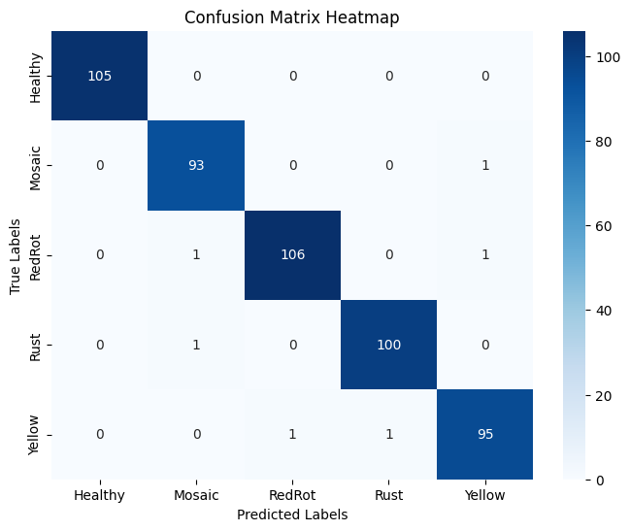
For Better Visualization we can used Confusion Matrix as shown:

Slide 27
For proper understanding of the performance of our model, we compare our model with other proposed models:
Model | Accuracy
MLTSDC | 98.81
U-RswinT | 97.81
DeepLabV3 | 95.57

Slide 28
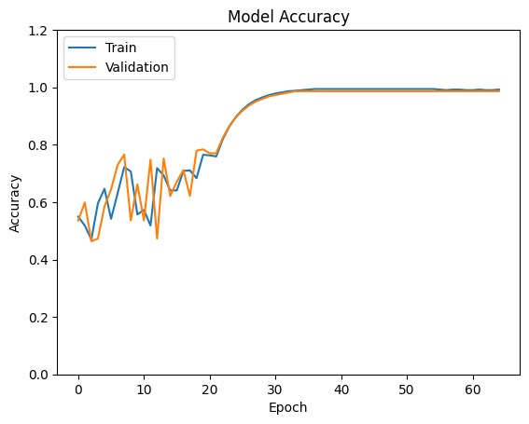
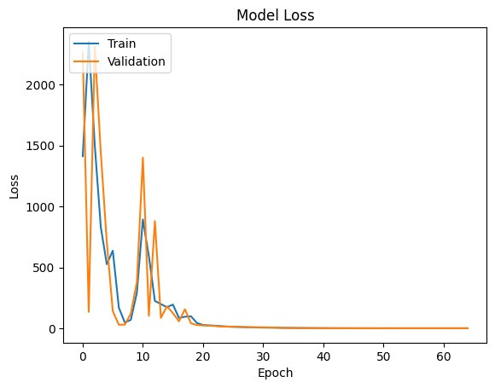
Accuracy and Loss graphs at level 1

Slide 29
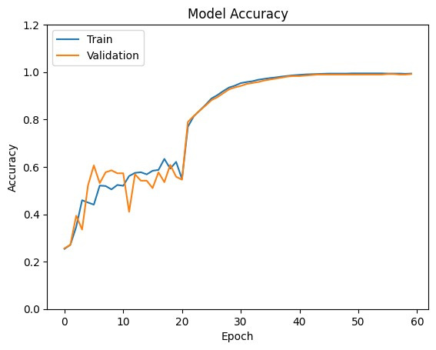
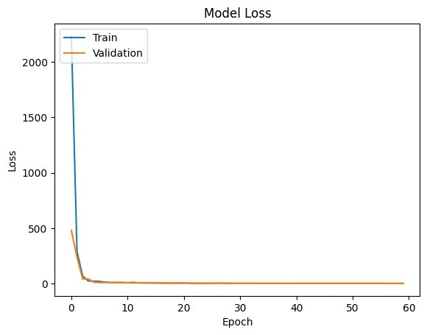
Accuracy and Loss graphs at level 2

Slide 30
12
Conclusion

Slide 31
Conclusion
The Multi Level Transformer model achieved an outstanding overall accuracy of 98.81% in apple disease classification.
This performance surpassed that of past Segmentation and Transformer models, which attained accuracies of 97.81%, 95.57% respectively.
The superior accuracy of the Multi Level Transformer underscores the efficacy of self-attention mechanisms and multi level classification.
These results highlight the potential of Multi Level Transformer architectures in advancing agricultural technology for improved disease management and enhanced global food security.

Slide 32
13
Future
Work

Slide 33
Future Work
To scale an AI model initially designed for a single crop to be applicable in broader agricultural contexts, it must be adapted to handle a diverse range of crops, each with distinct characteristics, diseases, and growth patterns. This requires expanding the dataset to include multiple crops and ensuring that each crop’s specific traits, such as disease types, growth stages, and environmental conditions, are accurately labeled.
Additionally, the model's architecture may need to be adjusted to accommodate the variability in crop-related data, potentially using multi-task learning or specialized models for different crops while maintaining generalization across the entire agricultural spectrum.
These future enhancements will not only broaden the applicability of our model but also ensure its practical utility in real-world environments, where access to high-performance hardware may be limited.

Slide 34
14
References

Slide 35
References
[1] R. Viswanathan • G. P. Rao, Disease Scenario and Management of Major Sugarcane Diseases in India
[2] Xuechen Li, Xiuhua Li, Muqing Zhang, Qinghan Dong, Guiying Zhang, Zeping Wang, Peng Wei, SugarcaneGAN: A novel dataset generating approach for sugarcane leaf diseases based on lightweight hybrid CNN-Transformer network.
[3]Krizhevsky, A., Sutskever, I., Hinton, G.E., 2012. ImageNet classification with deep
convolutional neural networks. Adv. Neural Inf. Process. Syst. 25 (2), 1097–1105.
[4]Ashish Vaswani, Noam Shazeer, Niki Parmar, Jakob Uszkoreit, Llion Jones, Aidan N. Gomez, Lukasz Kaiser, Illia Polosukhin. (2017). Attention Is All You Need. arXiv preprint arXiv:1706.03762, 2017.
[5] Edward J. Hu, Yelong Shen, Phillip Wallis, Zeyuan Allen-Zhu, Yuanzhi Li, Shean Wang, Lu Wang, Weizhu Chen, LoRA: Low-Rank Adaptation of Large Language Models, arXiv preprint arXiv:2106.09685v2

Slide 36
Thank You!

